Slide 1

Team Details
Team Name: WIZARD WARRIORS
Team Leader Name: S.T.AKHILEASH
Problem Statement: ENHANCING AGRICULTURE USING AI

Slide 2

PROTOTYPE DESCRIPTION
The integration of Artificial Intelligence (AI) and the Internet of Things (IoT) into agriculture brings groundbreaking advancements in precision farming, smart irrigation, automated equipment, predictive analytics, and crop monitoring. This prototype leverages AI and IoT to optimize resources, enhance yields, and reduce environmental impact.
In precision farming, IoT sensors collect real-time data on soil, crops, and environmental conditions, which AI analyzes to provide actionable insights. Smart irrigation systems use this data to regulate water usage efficiently. AI-driven automated equipment performs tasks like planting, harvesting, and weeding with high precision, reducing labor costs and boosting efficiency.
Predictive analytics forecast weather, pest infestations, and disease outbreaks, enabling proactive measures. Crop monitoring systems provide real-time insights on growth and nutrient levels through IoT sensors. This prototype represents a major advancement in sustainable and efficient farming, harnessing AI and IoT to address modern agricultural challenges.

Slide 3
OPPORTUNITIES
How Different from Existing Ideas
Comprehensive Integration: Unlike existing solutions that often use AI or IoT separately, this approach integrates both technologies for a holistic and synergistic farm management system.
Real-Time and Predictive Insights: Provides continuous real-time monitoring and advanced predictive analytics, enabling proactive decision-making and timely interventions.
Problem-Solving Capability
Resource Optimization: Efficiently manages and monitors resources, reducing waste and ensuring optimal use of water, fertilizers, and pesticides, thereby lowering costs and improving yields.
Risk Mitigation: Predictive analytics anticipate adverse weather events, pest infestations, and disease outbreaks, allowing farmers to take preventive measures and reduce potential losses.

Slide 4
FEATURES OF PROTOTYPE
Precision Farming
Real-Time Data Collection: Use IoT sensors to gather information on soil conditions, crop health, and environmental factors.
AI Analysis: Leverage AI algorithms to interpret data and generate actionable insights.
Smart Irrigation
Efficient Water Management: Utilize IoT sensors and AI to optimize water usage based on soil moisture and weather conditions.
Automated Control Systems: Implement smart irrigation systems to regulate water distribution.
Predictive Analytics
Data Integration: Aggregate data from various IoT devices.
Forecasting Models: Use AI to predict weather patterns, pest infestations, and disease outbreaks.
Proactive Measures: Provide early warnings and recommendations for preventive actions.
Real-Time Insights: Analyze data to offer real-time insights and recommendations for crop management.

Slide 5
PROCESS FLOW DIAGRAM
USE-CASE DIAGRAM
IOT SENSORS
FARMERS
DATA TRANSMISSION
IOT SYSTEM
DATA STORAGE
AI SYSTEM
DATA PROCESSING(AI)
WEATHER SERVICE
ACTUATORS
USER INTERFACE

Slide 6
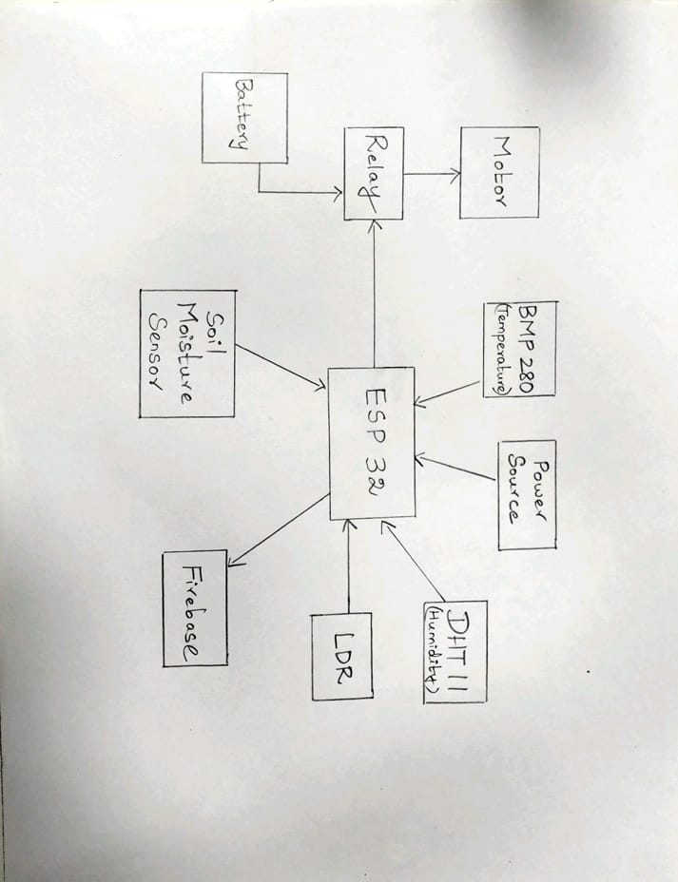
Wireframes/Mock diagrams of the proposed solution

Slide 7
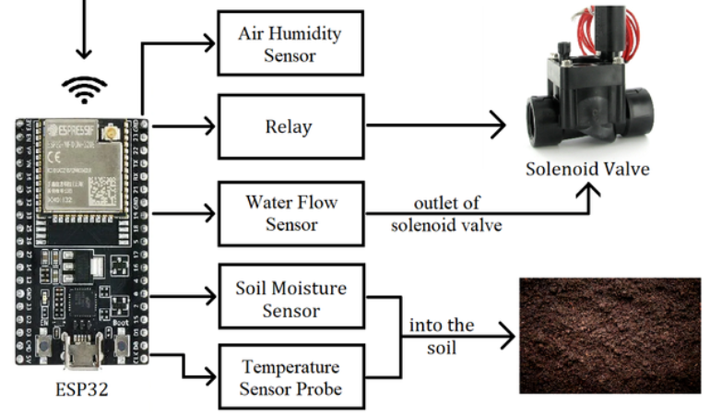
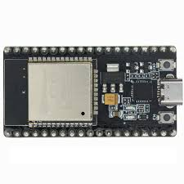
Architecture diagram of the proposed solution

Slide 8
Technologies to be used in the solution
HARDWARE | SOFTWARE
ESP32 | ARDUINO IDE
SOIL MOISTURE SENSOR | FIREBASE
MOTOR OR SOLENOID VALVE | PANDAS
HUMIDITY SENSOR(DHT11) | TENSORFLOW
LDR SENSOR | GITHUB
TEMPERATURE SENSOR(BMP280) | LIBRARIES FOR SENSORS
POWER SOURCE | SCIKIT

Slide 9
PROTOTYPE COST
HARDWARE | COST
ESP32 | 700
SOIL MOISTURE SENSOR | 150
MOTOR OR SOLENOID VALVE | 200
HUMIDITY SENSOR(DHT11) | 100
LDR SENSOR | 60
TEMPERATURE SENSOR(BMP280) | 400
POWER SOURCE | 50
Total Cost Production = 1660

Slide 10
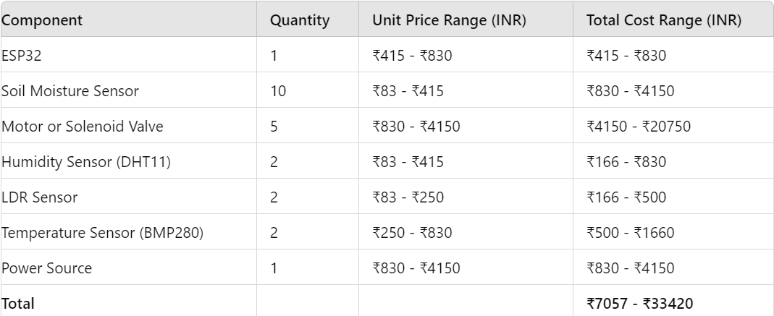
ESTIMATED IMPLEMENTATION COST OF COMPONENTS FOR 1 ACRE

Slide 11
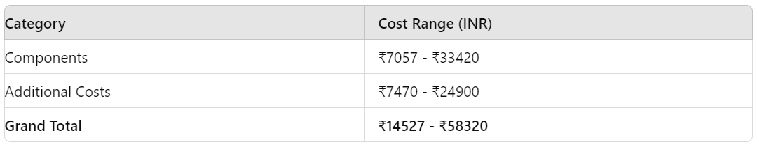
ESTIMATED IMPLEMENTATION COST OF COMPONENTS FOR 1 ACRE

Slide 12
Snapshots of the prototype

Slide 13
Prototype Performance Report/Benchmarking

Slide 14
Additional Details/Future Developments (if any)
Robotics and Automation:
Autonomous Vehicles: Develop autonomous tractors, harvesters, and drones that can perform various agricultural tasks with minimal human intervention.
Robotic Weeding: Implement robotic systems for automated weeding, reducing the need for chemical herbicides and manual labor.
Integration with Blockchain Technology:
Supply Chain Transparency: Use blockchain to track and verify the entire agricultural supply chain, ensuring transparency and traceability from farm to table.
Smart Contracts: Implement smart contracts for automated transactions and agreements between farmers, suppliers, and buyers.
Community and Farmer Engagement:
Training Programs: Provide comprehensive training programs for farmers to understand and effectively use the AI and IoT systems.
Collaborative Platforms: Create platforms for farmers to share data, best practices, and success stories to foster a collaborative agricultural community.

Slide 15
Prototype Resources:
GitHub Public Repository Link:
Demo Video Link (3 Minutes)
Final Product Link:

Slide 16


